Slide 1


Probability 1
Number of favourable outcome
Probability
$$=$$
Total number of possible outcome
Example
Probability of getting tail by tossing a coin
Getting tail only
1
$$=$$
2
Getting tail or head

Slide 2
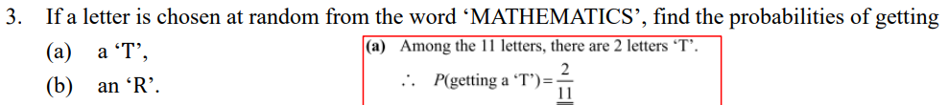






2 ‘T’ in MATHEMATICS
2
(a)
P(getting a T)
$$=$$
11
11 letter in MATHEMATICS
0 ‘R’ in MATHEMATICS
0
(b)
$$=$$
P(getting an R)
11
11 letter in MATHEMATICS

Slide 3
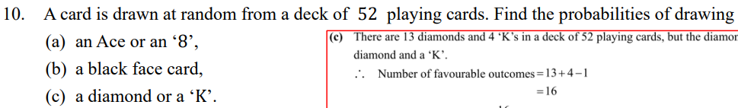

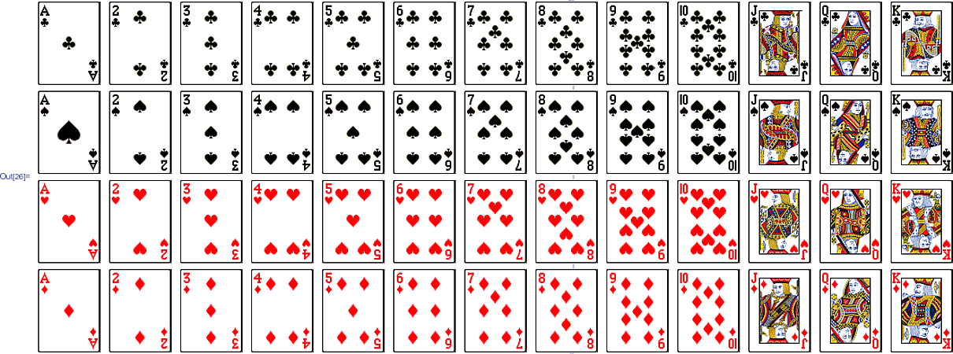
















(a)
P(an ace or an ‘8’)
4
$$+$$
4
$$=$$
52
2
$$=$$
13
(b)
P(a black face card)
6
$$=$$
52
4
$$=$$
13
(c)
P(a diamond or a ‘K’)
13
$$+$$
4
$$−$$
1
4
$$=$$
$$=$$
52
13

Slide 4










Number of female stuff
Probability
$$=$$
Total number of stuff
6
n
$$=$$
$$+$$
17
n
33
6n
$$+$$
198
$$=$$
17n
n
$$=$$
18

Slide 5
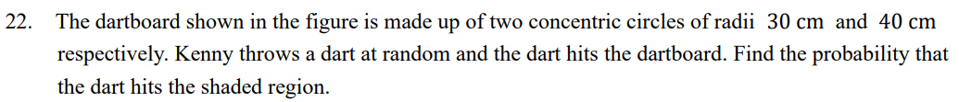
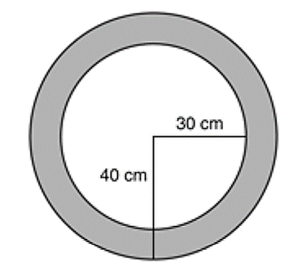





















2
$$×$$
(
Area of the dartboard
40)
$$=$$
$$π$$
$$=$$
1600$π$
2
cm
2
2
$$−$$
$$×$$
(
$$×$$
(
30)
Area of the shaded region
$$=$$
$$π$$
40)
$$π$$
$$=$$
700$π$
2
cm
700$π$
$$=$$
P(hits the shaded region)
1600$π$
7
$$=$$
16

Slide 6



Probability 2
Tree diagram
List out all the possible outcomes
Example
1st Toss
2nd Toss
Possible outcome
Head
HH
Head
Tail
HT
Head
TH
Tail
Tail
TT
2
1
$$=$$
$$=$$
P(getting exactly 1 head and 1 tail)
4
2

Slide 7
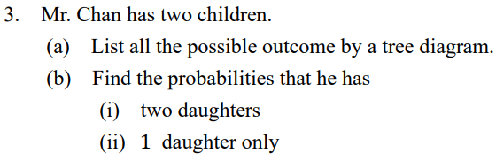







1
(bi)
$$=$$
(a)
Child 1
Child 2
Possible outcome
P(two daughters)
4
2
M
MM
(bii)
P(one daughter only)
$$=$$
4
M
1
F
MF
$$=$$
2
M
FM
F
F
FF

Slide 8

Tabulation
List out all the possible outcomes
Example
First toss
H
T
Second toss
H
HH
HT
T
TH
TT
Possible outcome
$$=$$
HH, HT, TH, TT

Slide 9
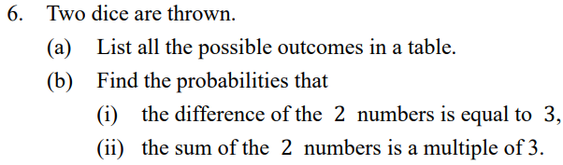








(a)
First dice
(bi)
P(difference is equal to 3)
1
2
3
4
5
6
Second dice
6
$$=$$
1
(1,1)
(1,2)
(1,3)
(1,4)
(1,5)
(1,6)
36
2
(2,1)
(2,2)
(2,3)
(2,4)
(2,5)
(2,6)
1
$$=$$
6
3
(3,1)
(3,2)
(3,3)
(3,4)
(3,5)
(3,6)
(bii)
P(sum is a multiple of 3)
4
(4,1)
(4,2)
(4,3)
(4,4)
(4,5)
(4,6)
12
$$=$$
5
(5,1)
(5,2)
(5,3)
(5,4)
(5,5)
(5,6)
36
6
(6,1)
(6,2)
(6,3)
(6,4)
(6,5)
(6,6)
1
$$=$$
3

Slide 10
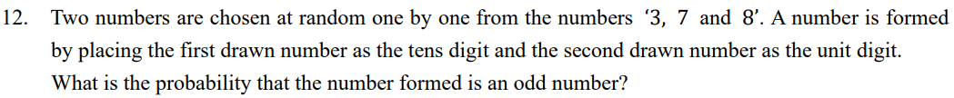






Tens digit
Unit digit
Possible outcome
P(Odd number)
3
3
33
$$=$$
7
37
6
3
8
38
1
3
73
$$=$$
2
7
7
77
8
78
3
83
8
7
87
8
88

Slide 11
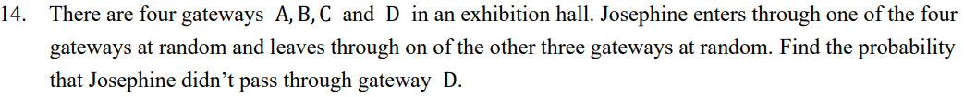






Enter
A
B
C
D
Leave
(
(
(
A
B,A)
C,A)
D,A)
B
(
(
A,B)
C,B)
(
D,B)
C
(
(
A,C)
B,C)
(
D,C)
D
(
(
(
A,D)
B,D)
C,D)
P(didn’t pass through gateway B)
6
$$=$$
12
1
$$=$$
2

Slide 12
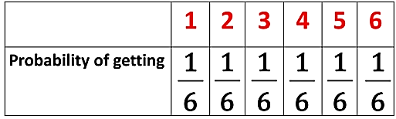















Probability 3
Expected value
$$=$$
Probability of the event
$$×$$
Value of the event
Example
1
1
1
1
1
1
Expected value
$$=$$
$$×$$
1
$$+$$
$$×$$
2
$$+$$
$$×$$
3
$$+$$
$$×$$
4
$$+$$
$$×$$
5
$$+$$
$$×$$
6
6
6
6
6
6
6
$$=$$
3.5

Slide 13
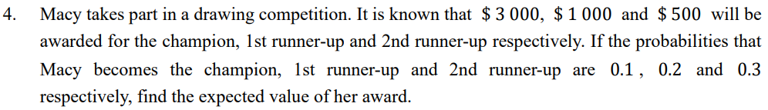














Expected value
$$=$$
0.1
$$×$$
3000
$$+$$
0.2
$$×$$
1000
$$+$$
0.3
$$×$$
500
$$=$$
$650

Slide 14






























Expected value of multiple event
=
Probability of first event
$$×$$
Marks of first events
$$+…+$$
Probability of last event
$$×$$
Marks of last events
Example
Expected value of rolling dice twice
1
1
1
1
1
1
1
1
1
$$=$$
$$×$$
1
$$+$$
$$×$$
2
$$+$$
$$×$$
3
$$+$$
$$×$$
4
$$+$$
$$×$$
5
$$+$$
$$×$$
6
$$+$$
$$×$$
1
$$+$$
$$×$$
2
$$+$$
$$×$$
3
$$+$$
6
6
6
6
6
6
6
6
6
1
1
1
$$×$$
4
$$+$$
$$×$$
5
$$+$$
$$×$$
6
6
6
6
$$=$$
3.5
$$+$$
3.5
$$=$$
7

Slide 15















Expected total mark after the two tosses
$$−$$
$$+$$
$$×$$
$$+$$
$$×$$
$$−$$
20)
$$=$$
0.5
$$×$$
50
$$+$$
0.5
$$×$$
(
20)
0.5
50
0.5
(
$$=$$
15
$$+$$
15
$$=$$
30

Slide 16
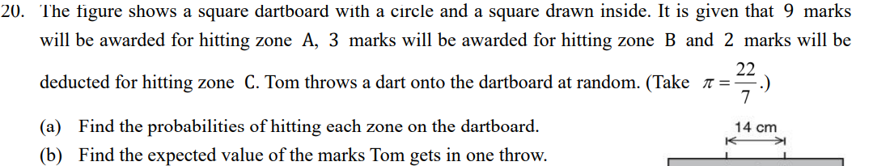
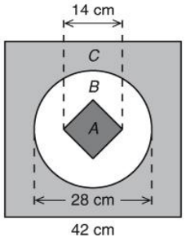


































$$=$$
2
$$=$$
1764
2
Area of the dart board
(
cm
(a)
42)
1
2
$$=$$
$$×$$
$$×$$
14
$$×$$
7
$$=$$
98
cm
Area of zone A
2
2
$$=$$
$$π$$
2
$$=$$
2
$$×$$
(
$$−$$
518
cm
Area of zone B
14)
98
$$=$$
1764
$$−$$
518
$$−$$
98
$$=$$
1148
2
Area of zone C
cm
98
1
1
37
41
P(hitting zone A)
$$=$$
$$=$$
$$=$$
$$×$$
$$+$$
$$×$$
$$+$$
$$×$$
$$−$$
2)
1764
18
(b)
Expected value
9
3
(
18
126
63
518
37
5
P(hitting zone B)
$$=$$
$$=$$
$$=$$
1764
126
63
1148
41
P(hitting zone C)
$$=$$
$$=$$
1764
63

